Slide 1

TWITTER CLIMATE CHANGE SENTIMENT ANALYSIS
Team Members:
1. Eric Cheruiyot
2. Geoffrey Ongeri
3. Antonia Mulinge

Slide 2
Contents
Introduction
Data Understanding
Deep dive on the Teet Sentiments
Modeling and Validation
Conclusion and Recommendations

Slide 3
Introduction
A changing climate is one of the most world global challenges. This has led to world’s most influential leaders and organizations spearheading the discussion on how to overcome the challenge. In addition twitter is a platform which has led people either support climate change or not.
Problem Statement
Twitter being one of the most influential ways of passing information and analysing trends on various issues and in our case climate change, we chose to analyse tweets data to predict whether a tweet is pro-climate change, anti-climate change , from a news segment or just a neutral part with not take in climate change issues.
We used NN Model as our measure of success

Slide 4
Data Understanding
The dataset contains 43943 rows and 3 columns
The rows represent tweets and each tweet has 3 features representing columns
Sentiment
Message
TweetId
Data Source: Kaggle
Demo: Colab Notebook
Our Target Column: Sentiment - I.e Tweets

Slide 5
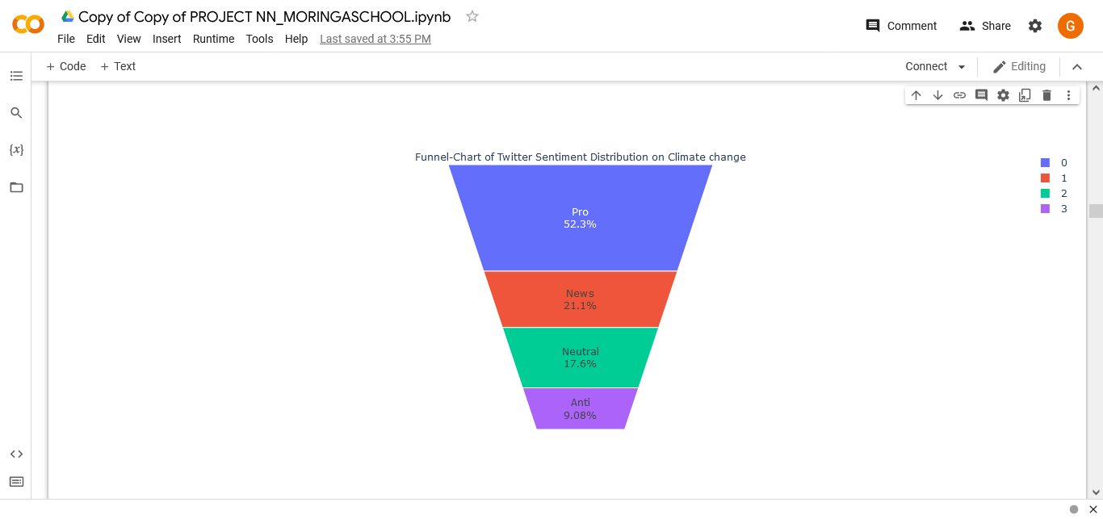
Visualizing the sentiment distribution
Most tweets were from Pro Sentiments With over 22000 tweets

Slide 6
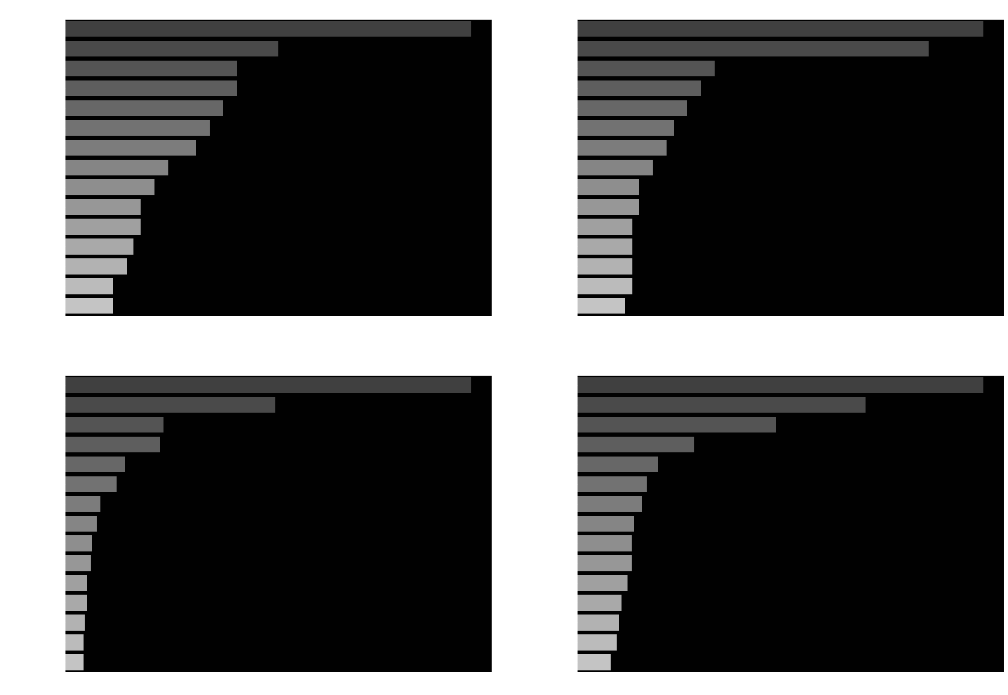
Most Hashtagged Wordings

Slide 7
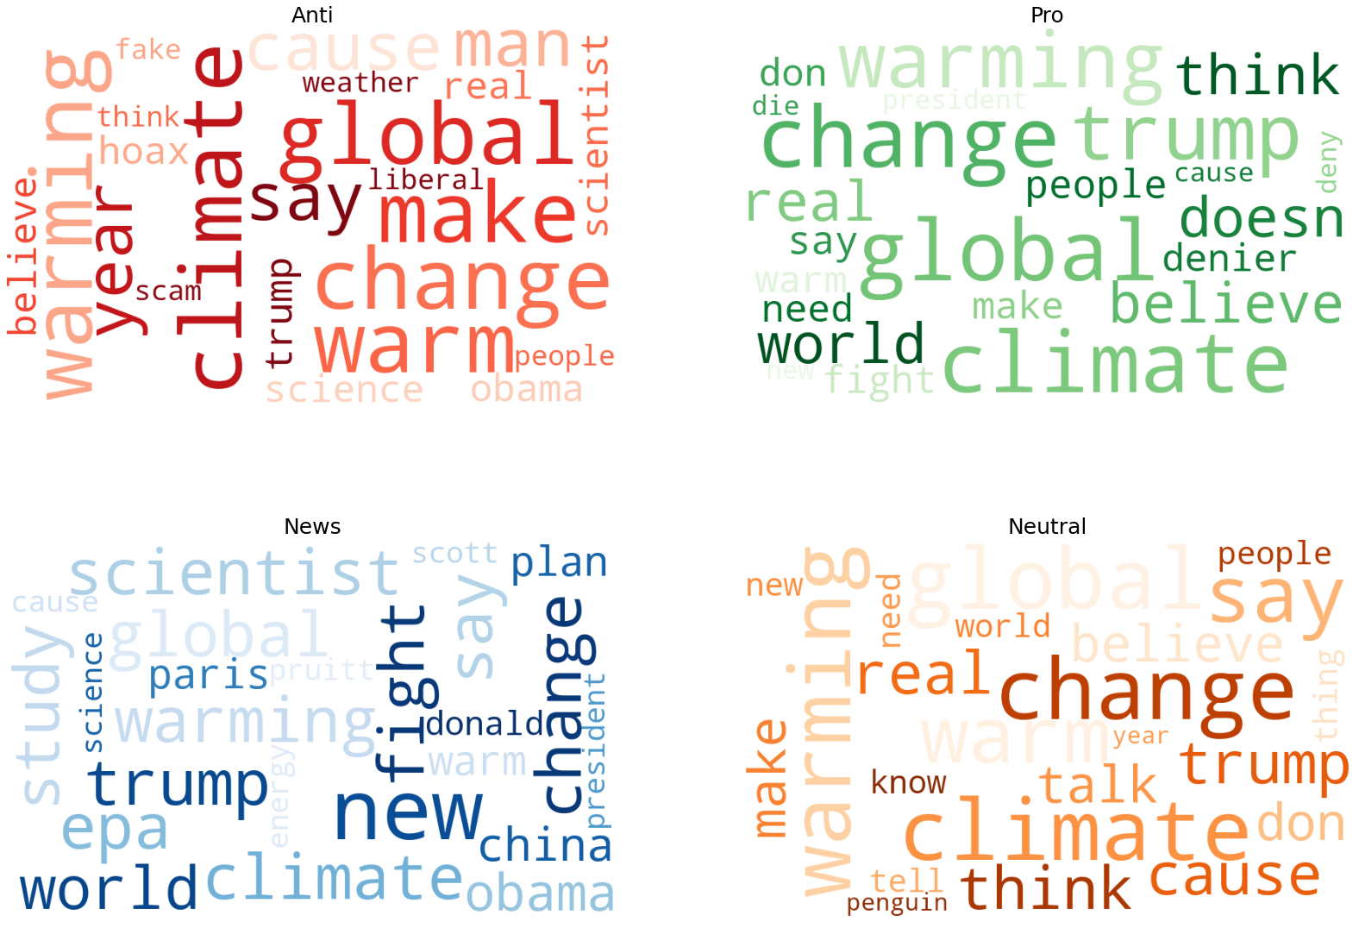
Word Cloud Presentation of top Buzzwords

Slide 8
Modelling
Model Used: Tensorflow incorporated with Keras Fucntional API
Sample size used for training: 10,000
Training size 80%
Accuracy With the training dataset : 64%
Validation accuracy with the dataset: 63%
Conclusion: The data was not overfit

Slide 9
Conclusions and Recommendations
Modelling/training this text data set is complicated and might be biased if the imbalanced data is not handled well.
Using Tensorflow- Keras Functional API modeling algorithm might not bring the best accuracy so it is always advised to use different models and choose the best.
Validating or training the model with other faster Tensorflow RNNs like GRU is recommended if memory is limited.
Adding more layers to the Model might have improved the model performance
Majority of tweets support climate change.

